Slide 1



Environmental Studies

Slide 2


Slide 3
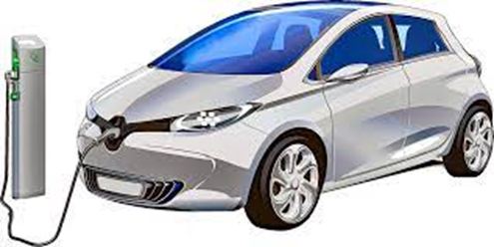
Introduction:
With the rapid increase in the Indian Automobile market, Electric Vehicles (EVs) are turning into a promising channel towards improving air quality, energy security and economic opportunity. The government of India recognizes the urgency to look at sustainable mobility solutions to reduce dependency on imported energy sources, reduced greenhouse gas emissions and mitigate adverse impacts of transportation including global warming. The carbon dioxide emission can be reduced by taking precautionary measures to reduce the catastrophic climate change that threatens the species of this planet. Major endeavours have been taken for minimal use of fossil fuels for power generation, transport propulsion, reduction of energy consumption and protection of carbon sequestration. EVs could be the alternative to decrease the carbon dioxide gas emission.
Though the use of EVs has begun, people are still depending upon fossil fuel powered vehicles. However, the EVs are facing challenges on life cycle assessment (LCA), charging, and driving range compared to the conventional fossil fueled vehicles. The CO2 emitted from Electric vehicle production is (59%) more than that of the ICEV. The ICEV generates 120 g/km of CO2 emission on a tank to wheel basis, but from the point of view of the LCA, this increases to 170–180 g/km.
MAJOR PROBLEMS OF ELECTRICAL VEHICLES
Harmful emission from the transport sector, and investment by different OEMs, there arises a concern for growing more and low cost EVs in the forthcoming years. Several factors such as technological advancement, reduction in the cost of a vehicle, Govt policy support, vehicle purchasing incentives, parking benefit, and good public charging infrastructure facility could result in the uptake of EVs in India. As the production of EVs is very low, the overall share of EVs in the Indian market is negligible. EVs can be i) electric two wheelers (E2Ws) like electric bicycles and electric scooters, ii) three wheelers like E- rickshaws and iii) four wheeler consists of electric cars. India's first electric car company “The Reva Electric car” which launched its car in the early 2000s focuses to produce affordable cars through advanced technology. The only BEV manufacturer, Mahindra Electric mobility Ltd is leading in the Indian market. Other major HEV manufacturer companies operating in Indian markets are Toyota Kirloskar Motor Pvt.

Slide 4
In 2014, India's overall greenhouse gas emission amounted to 3202 million metric tonnes of carbon dioxide equivalent, which accounted for 6.55% of global greenhouse gas emissions. In India, 68% of greenhouse gas emission come from the energy sector, followed by agriculture, manufacturing processes, improvements in land use and forestry, and waste adding 19.6%, 6.0%, 3.8% and 1.9% relative to greenhouse gas emission .An electric vehicle can be used as a flexible load for standardizing the grid with a substantial share of fluctuating renewable energy generation .The owners of the Electric vehicle do not have a transaction in the electricity market due to the low power of a single transaction considered a current practice for the estimation of current smart policies, which were established in advance for changing scenarios and are exogenous. To exploit the full potential of an EV, flexible load, and smart charging strategies should be executed. In another study by revealed that, the EV users organized themselves to impart to the aggregator as far as timing and energy necessity. The timing requirement defines the time by which a charging operation must be completed, whereas the battery level supports the energy requirement. In a similar study conducted by indicated that a decentralized framework and a central entity should provide the pricing signal to owners of electric vehicles expecting the centralized and decentralized frameworks to overlap.
Brady and Mahony, 2016 studied the stochastic simulation methodology of an electric vehicle for generating a dynamic travel schedule and charging profile for the propulsion of the EVs in this real world. They concluded that when the conditions of parking time distribution are increased, the parking time distribution accuracy, as well as the overall accuracy of the model, would be improved. Morrissey et al., 2016 studied some electric vehicle consumers and revealed that they prefer charging their vehicles at their home during peak electricity demand in the evening. Foley et al., 2013 studied the impact of EV charging under peak and off-peak charging scenarios in a single extensive electricity market in Ireland and found that the peak charging is detrimental compared to off-peak charging. Doucette and Mc .C , 2011 conducted a study on the BEV and the PHEV to determine their carbon dioxide emission level and compared their results with CO2 emission from Ford Focus. Stain ., 2013 studied the essential tools and strategies for introducing new technology and innovation by exploring key barriers to an EV in two countries. Yu et al., 2012 introduced a driving pattern recognition technique for evaluating the driving range of the EVs based on the trip segment partitioning algorithm. Hayes et al., 2011 investigated for different driving conditions and topographies by building up a vehicle model. Salah et al., 2015 studied the EVs charging impact on Swiss distribution substation and found that higher penetration level and dynamic tariff increases the risk of overloads at some locations

Slide 5
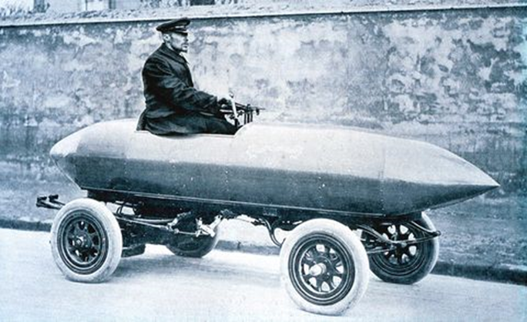
These parameters are then compared with each other by their range type. The impact of various classifications of charging methodology of electric vehicles on the national grid and the storage utilization has been presented by studied the model-based non-linear observers for estimating the torque of permanent magnet synchronous motor for hybrid electric vehicles. The maximum transmissible torque method is determined by for increasing the antiskid execution of the torque control framework and to improve the stability of the Electric vehicles. Lu et al., 2013 made a review of key issues for Li-ion battery management in an Electric vehicle. The issue such as voltage of the battery cell, battery state estimation (battery SOC, SOH, DOD and SOF), battery equalization and uniformity and fault analysis of the battery can provide motivation for the research and design of the battery management system. Reviews on optimal management strategies, energy management system and the modelling approach for electric vehicles.

Slide 6
Vehicle types
It is generally possible to equip any kind of vehicle with an electric power-train.
Ground vehicles
Pure-electric vehicles
See also: Electric car and Battery electric vehicle
A pure-electric vehicle or all-electric vehicle is powered exclusively through electric motors. The electricity may come from a battery (battery electric vehicle), solar panel (solar vehicle) or fuel cell (fuel cell vehicle).
Hybrid EVs
This section is an excerpt from Hybrid electric vehicle.
A (HEV) is a type of hybrid vehicle that combines a conventional internal combustion engine(ICE) system with an electric propulsion system (hybrid vehicle drivetrain). The presence of the electric powertrain is intended to achieve either better fuel economy than a conventional vehicle or better performance. There is a variety of HEV types and the degree to which each function as an electric vehicle (EV) also varies. The most common form of HEV is the hybrid electric car, although hybrid electric trucks (pickups and tractors), buses, boats and aircraft also exist.
Modern HEVs make use of efficiency-improving technologies such as regenerative vehicles which convert the vehicle’s kinetic energy to electric energy, which is stored in a battery or supercapacitor. Some varieties of HEV use an internal combustion engine to turn an electric generator, which either recharges the vehicle's batteries or directly powers its electric drive motors; this combination is known as a motor_generator. Many HEVs reduced idle emissions by shutting down the engine at idle and restarting it when needed; this is known as a start-stop system. A hybrid-electric produces lower tailpipe emissions than a comparably sized gasoline car since the hybrid's gasoline engine is usually smaller than that of a gasoline-powered vehicle. If the engine is not used to drive the car directly, it can be geared to run at maximum efficiency, further improving fuel economy.

Slide 7
Literature Review: The various articles, previous reports used for this projects has come from various sources Business Standard Newspapers , Mini Newspapers.
Main article : History of electric vehicle
Electric motive power started in 1827, when Hungarian priest A . Jedlik built the first crude but viable electric motor, which used a stator, rotor, and commutator; and the next year he used it to power a small car. In 1835, professor S brand of the University of Groningen, in the Netherlands, built a small-scale electric car, and sometime between 1832 and 1839, Robert Anderson of Scotland invented the first crude electric carriage, powered by non-rechargeable primary cells. American blacksmith and inventor Thomas Davenport built a toy electric locomotive, powered by a primitive electric motor, in 1835. In 1838, a Scotsman named Robert Davidson built an electric locomotive that attained a speed of four miles per hour (6 km/h). In England a patent was granted in 1840 for the use of rails as conductors of electric current, and similar American patents were issued to Lilley and Colten in 1847
The first mass-produced electric vehicles appeared in America in the early 1900s. In 1902, the Studebaker Automobile Company entered the automotive business with electric vehicles, though it also entered the gasoline vehicles market in 1904. However, with the advent of cheap assembly line cars by Ford Motor Company, the popularity of electric cars declined significantly.

Slide 8
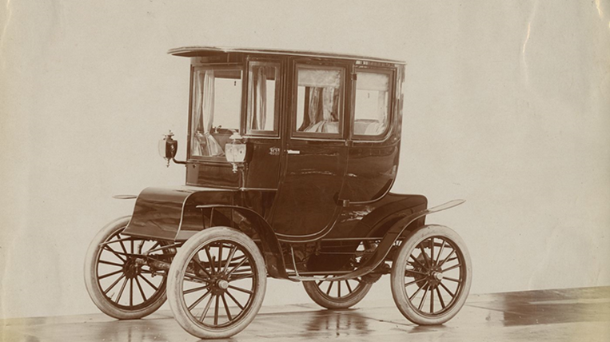
Most producers of passenger cars opted for gasoline cars in the first decade of the 20th century, but electric trucks were an established niche well into the 1920s.A number of developments contributed to a decline in the popularity of electric cars .Improved road infrastructure required a greater range than that offered by electric cars, and the discovery of large reserves of petroleum in Texas, Oklahoma, and California led to the wide availability of affordable gasoline/petrol, making internal combustion powered cars cheaper to operate over long distances. Electric vehicles were not seldom marketed as a women's luxury car, which may have been a stigma among male consumers.Also, internal combustion powered cars became ever-easier to operate thanks to the invention of the electric starter by Charles Kettering in 1912,[which eliminated the need of a hand crank for starting a gasoline engine, and the noise emitted by ICE cars became more bearable thanks to the use of the muffler which Hiram Percy Maxim had invented in 1897. As roads were improved outside urban areas, electric vehicle range could not compete with the ICE. Finally, the mass of production of gasoline-powered vehicles by Henry Ford in 1913 reduced significantly the cost of gasoline cars as compared to electric cars.

Slide 9
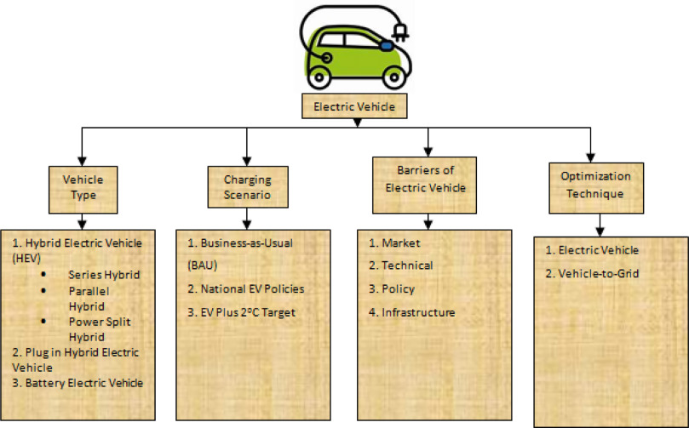
Materials and Methods:
Methodology:
My Team studied various types of electric vehicles exiting at present across the world. Besides this, we have figured out the barriers of EV in the Indian market. Different types of optimization techniques are also discussed. The detailed overview on Electric Vehicles was studied and is presented in . This paper is structured into a few segments such as methodology describes the methodology explains the electric vehicle overview of all types of electric vehicle configuration followed by its charging scenario in barrier of EV the optimization technique for EV and V2G .

Slide 10
The report broadly covers topics on:
*/Market opportunity.
*/Target customers
*/Barriers to adoption.
*/ Conclusions
Market Opportunity:-
**distinctive styling
**improving speed
**torque characteristics
**will make EV usage a satisfying experience
TARGET CUSTOMERS:-
**"potential first movers“
**"might be willing to consider“
**category are from urban locations
**consisting of both genders
EVS are considered within the reach of the middle-class customer in most other markets, the manufacturers selling EVs in India would have to target the upper middle or rich customers.

Slide 11

BARRIERS TO EV ADOPTION
They are:
**Battery charge time
**Expected purchase price after government incentives
**Acceptable price premium
**Range anxiety
**Fuel prices
Acceptable battery charging time
- 8 hours 24%
4 hours 27%
2 hours to 30 minutes 49%
Expected purchase price after government incentives
In INR lakh
- <4 32%
- 4 to 7 33%
- 7 to 9 12%
In India, 76% of the total population surveyed would expect an electric vehicle to travel up to 320 kilometres per charge before they would consider purchasing one. This indicates a gap in expectations versus current EV range capabilities in India . While fuel price increase may not be the only factor that drives customers to buy EVs, it is afact that they have a mental benchmark of 130-150% of the current fuel prices that will make themreconsider EVs

Slide 12
Results And Discussion:
Be happy! We’re getting there. Just a small amount of writing to go from this point. The results and discussion are (relatively) cut and dried. But be sure to run them by all committee members and your chair before publishing or creating the poster, to make sure you haven't overlooked anything. And make sure they are congruent with your research purpose, objectives, hypothesis, and methods.
We are collecting about the major problems of Electrical vehicles in the world.
So, we have research :
^Electric Vehicles give very low mileage.
^Limited Driving range.
^High Costs.
^Battery Issues.
^Long Charging Time.
^Inadequate Charging Infrastructure along with issues with various power semiconductors and other devices.
^Power Equipment.
.

Slide 13


Asking Questions: Firstly we meet the people who drive the electric vehicles, ^Is Electric vehicle is better than Petrol vehicle? ^What are the advantages and disadvantages of electric vehicle? ^Which one gives better Average /Liter? ^What is the difference between petrol car and electric car with respect to driving ? Finally , we encourage the people who drives the electric vehicles.
We have take some videos and photos for whose using electric vehicles and we ask some queries and finally we have take some data about electric vehicles.

Slide 14


Slide 15

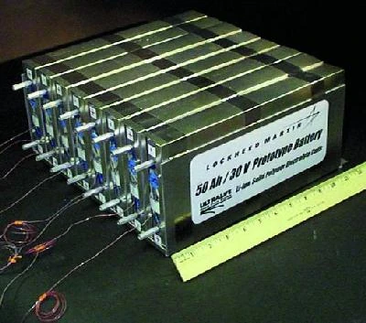
Conclusion:
Hybrid, Plug In Hybrid and Electric Vehicles are capable of increasing the fuel economy of vehicles but with an increase in the cost of buying compared to traditional vehicles. In general their decreased consumption of petroleum and increased productivity offers economic benefit to buyers, society, automakers and policymakers over the lifetime. This paper provides a detailed overview of the literature, overview, and guidelines for HEV, PHEV and BEV penetration rate studies Into the Indian Market. The recent initiatives and various subsidies by the Indian Government will help push the e-mobility drive in India. The development of a new concept of Vehicle-to-Grid can either deliver power to the grid or can be used to charge the battery when non-conventional energy sources are not available. This technology is an important aspect of energy security, renewable energy, and giving a great scope to deal with global warming issues.

Slide 16
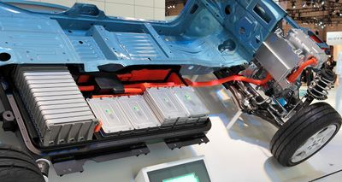
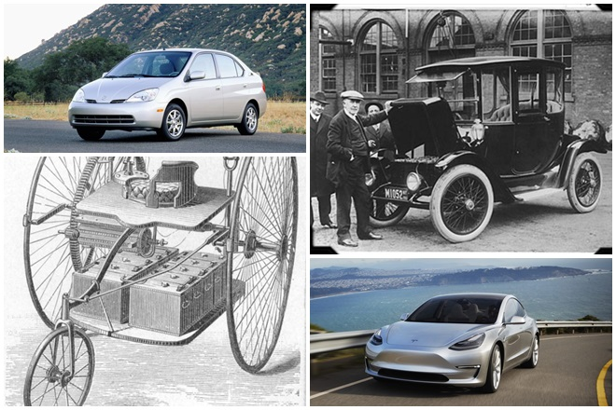
Sustainable Development: Affordable And Clean Energy
Ever since humans harnessed fire over 1.5 million years ago, combustion has been at the heart of our energy creation. Fire from wood was first used by humans to cook meat, provide warmth and protection from wild animals. It wasn’t until the early 19th century, that fossil fuels (coal, oil and natural gas) replaced wood as the primary source of energy generation. Today the vast majority, over 80%, of energy is still generated by fossil fuels, with nuclear comprising 10% and other renewable sources making up the rest . But the present dependence on fossil fuels, by an ever-growing world population, is contributing heavily to climate change and its increasingly devastating impacts on lives around the globe. And because fossil fuels are finite, alternatives must be found with adequate leeway to permit a seamless transition.

Slide 17
Cut-away of a Nissan Leaf battery pack Cut -away of a Nissan Leaf battery pack Climate concerns reignited the interest in electric cars, and over the past decade, electric vehicles have become an increasing percentage of global vehicles. Much of that has come as a result of the combination of governmental purchase subsidies and technological increases, namely reliability, range and practicality . Chemistry has always been at the heart of electric cars – batteries. With the resurgence of electric cars, Nickel Metal Hydride (Ni-MH) batteries were commonly used and have now largely been eclipsed by Lithium-ion (Li-ion) batteries. Li-ion batteries are lighter in weight, quicker to recharge, have no memory issues and generate less heat, making them highly popular . Sales of Li-ion batteries was a $30 billion industry in 2017 and is expected to grow to $100 billion in 2025. But for all its technical advantages, Li-ion batteries present sustainability and safety challenges (Nature, 2021).Extracting lithium, depending on location/source, is water and energy intensive.70% of cobalt for the battery electrode comes from the Democratic Republic of the Congo where child labor and safety issues are major concerns . Recycling Li-ion batteries also presents challenges between removal from the vehicle and regulatory requirements.

Slide 18
The Biggest Present Limitation It is a fact that electric cars, over their lifetime, generate fewer greenhouse gases (GHGs) than gas-powered cars. Although, during production of electric cars and batteries, GHGs are higher than the GHGs from the production of a gas vehicle . The biggest limitation to electric cars being close to a zero-emission vehicle is their need to recharge. The electricity needed to recharge the electric vehicle largely comes from power plants burning fossil fuels . In the US, electric power generation is the second largest user of fossil fuels – 28%. And that is comprised of 59% natural gas, 40% coal and 1% petroleum (US Energy Information Administration, 2020).Until renewables can provide the bulk of input to electric generation plants, the promise of electric cars and zero emissions will remain elusive. Outside the US, there are promising signs that renewables are establishing a foothold. Nuclear and renewables account for more than one-third (36.7%) of global electricity.
As world governments wrestle with how to adopt decarbonization and a zero-emission world, perhaps lessons learned from global government subsidies and incentives that successfully led to the large increase in the purchase of electric cars can be applied to revolutionize the electricity generation sector . Just as fossil fuels edged out wood as the principal global energy combustion source, let’s encourage and support our talented chemists, scientists and research labs to continue their research to make the capture, storage and distribution of renewable energy the gold standard in the decade ahead and help meet UN SDG Goal 7.

Slide 19
References:
[1]
R.T. Doucette, M.D. Mc C Modelling the prospects of plug-in hybrid electric vehicles to reduce CO2 emissions Appl. Energy, 88 (2011), pp. 2315-2323ArticleDownload PDF View Record in Scopus Google Scholar.
[2]
https:www.goldmansachs.com/insightsGoogle Scholar
[3]
https://en.wikipedia.org/wiki/Electric_vehicle_industry_in_IndiaGoogle Scholar
[4]
https://www.climatelinks.org/resources/greenhouse-gas-emissions-factsheet-indiaGoogle Scholar
[5]
W. Kempton, J. Tom Vehicle-to-grid power implementation: from stabilizing the grid to supporting large-scale renewable energy J. Power Sources, 144 (1) (2005), pp. 280-294ArticleDownload PDF View Record in Scopus Google Scholar
[6]
R.J. Bess, M.A. Matos Economic and technical management of an aggregation agent for electric vehicles: a literature survey Eur. Trans. Electric . Power, 22 (3) (2012), pp. 334-350 View PDF Cross Ref View Record in Scopus Google Scholar
[7]
N. Diana , A. Sivakumar, J . W. Pola k Modelling electric vehicles use: a survey on the methods Renew. Sustain. Energy Rev., 68 (2017), pp. 447-460ArticleDownload PDF View Record in Scopus Google Scholar
[8]
F . K ’s , Y. Uri Modelling power consumption by electric vehicles and its impact on power demand Electric. Eng. Japan ., 120 (4) (1997), pp. 40-47Google Scholar
[9]
J.E. Kang, W.W. Recker An activity-based assessment of the potential impacts of plug-in hybrid electric vehicles on energy and emissions using 1-day travel data Transp. Res. Part D: Transp. Environ., 14 (8) (2009), pp. 541-556ArticleDownload PDF View Record in Scopus Google Scholar
[10]
J. Dong, C. Liu, Z. Lin Charging infrastructure planning for promoting battery electric vehicles: an activity-based approach using multiday travel data Transp. Res. Part C: E . Technol., 38 (2014), pp. 44-55ArticleDownload PDF View Record in Scopus Google Scholar

Slide 20

By
Pranav G-12207954
NEELADRI YOGENDRA-12207966
RUPPA GIRIDHAR-12207968
K22RT SECTION_2022-2023,
LOVELY PROFESSIONAL UNIVERSITY,
PHAGWARA,PUNJAB

